Slide 1
A Simple Tutorial for Web Crawler
Yuye

Slide 2
Contents
Introduction
Requests
Challenges
Conclusion

Slide 3
Contents
Introduction
Requests
Challenges
Conclusion

Slide 4
Web Crawler
An Internet bot that systematically browses the World Wide Web
Main Usages: (1) Gather data. (2) Automatically perform single operations.

Slide 5
Three Steps
Send a request
Get the response
Parse the response (Sometimes)

Slide 6

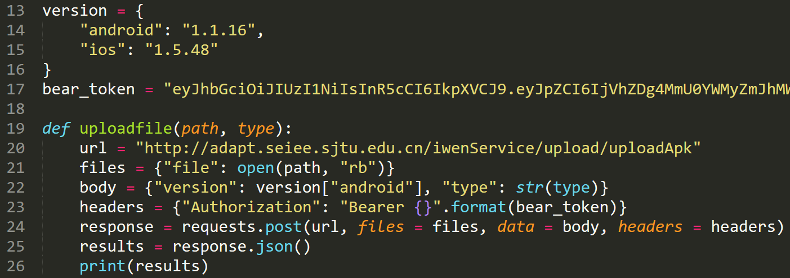
Update iWen Apk

Slide 7
Contents
Introduction
Requests
Challenges
Conclusion

Slide 8
Request types
GET: A client is seeking data from the server. Once the client has made a request for a resource, the server will then process the request, get the information or data and send it back to the client
DELETE: Sends a request to the server to delete a resource.
Notes:
A web request is a communicative message that is transmitted between the client, or web browsers, to the servers

Slide 9
Request types
PUT: This method can allow for the target URL to be entirely replaced with a new resource. PUT should be utilized to replace or overwrite a resource that the client is clearly aware of
POST: The Purpose of POST seeks to create or update the subordinate requested resources. This request does not store additional data but instead per request must be updated and refreshed or resubmitted
Notes:
A web request is a communicative message that is transmitted between the client, or web browsers, to the servers

Slide 10
Quiz: what is the corresponding mysql command?
Get
Put
Post
Delete
Select
Insert
Update
Delete

Slide 11
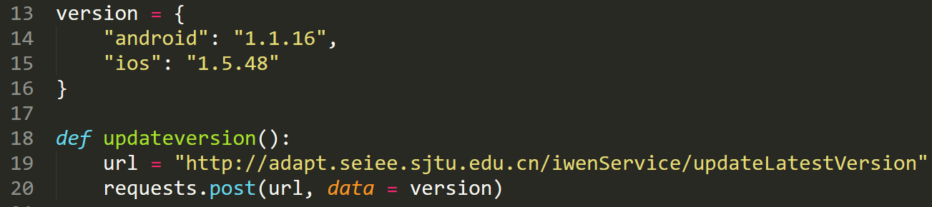
Update version number

Slide 12
Update Apk

Slide 13
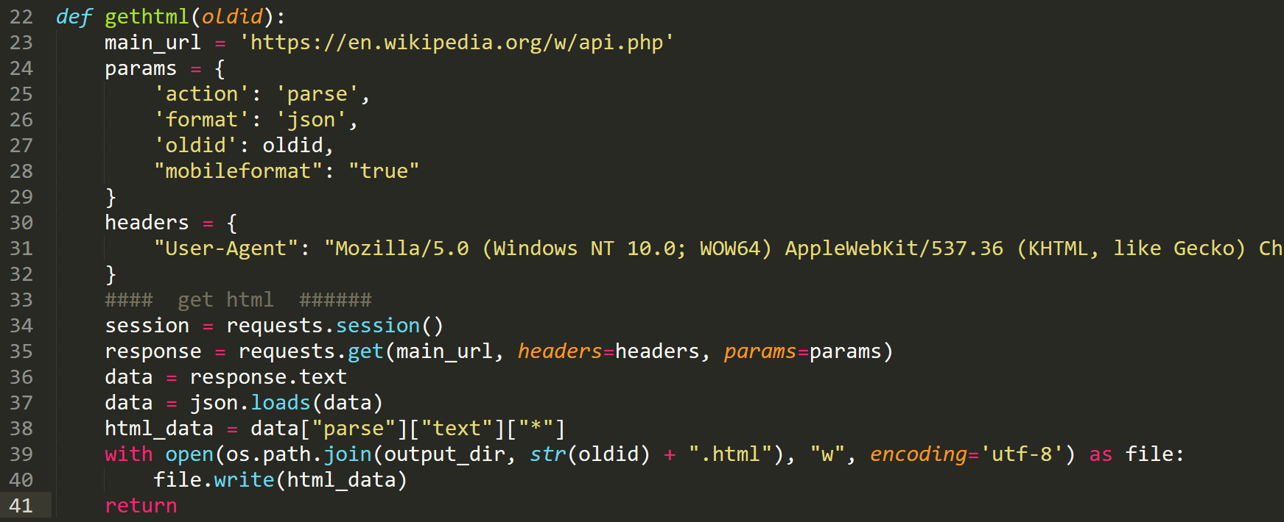
Gather data through api

Slide 14
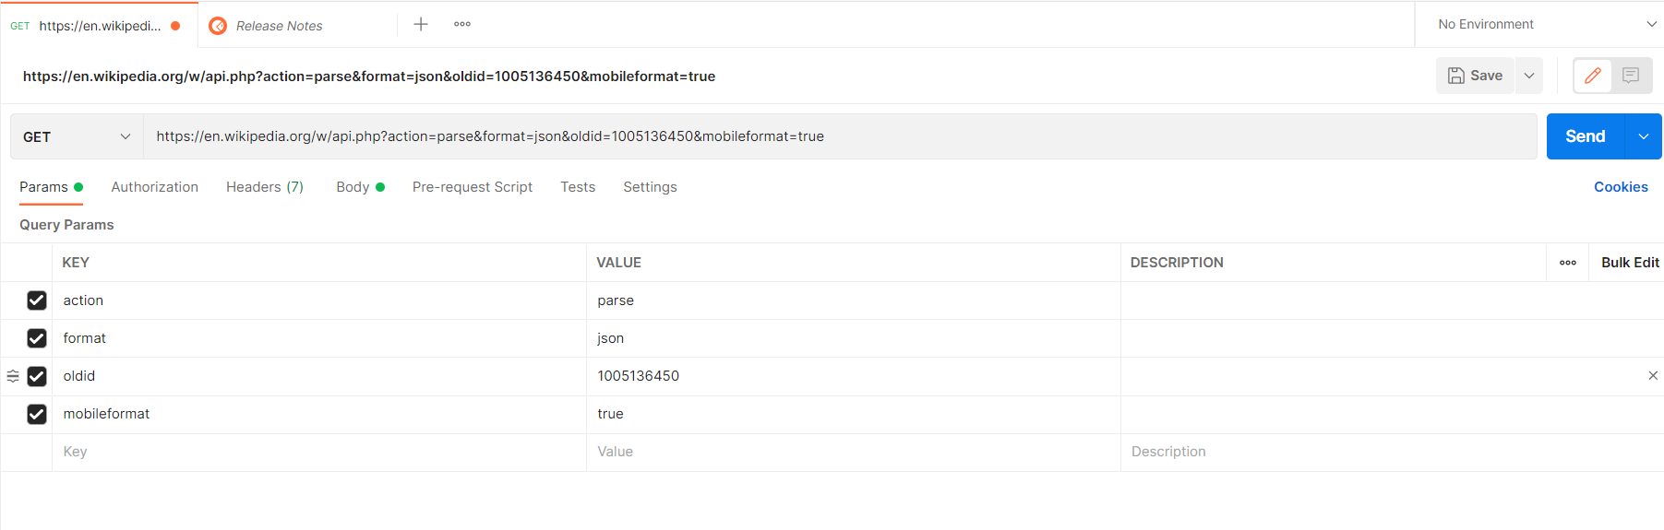
Postman

Slide 15
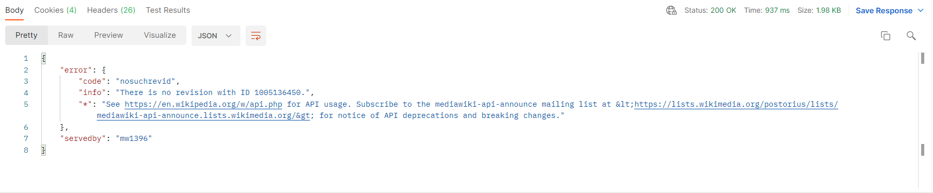
Postman

Slide 16
Don’t know which request to send?

Slide 17

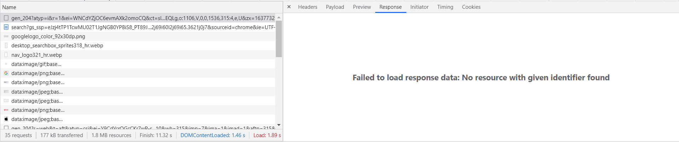
Chrome developer mode

Slide 18
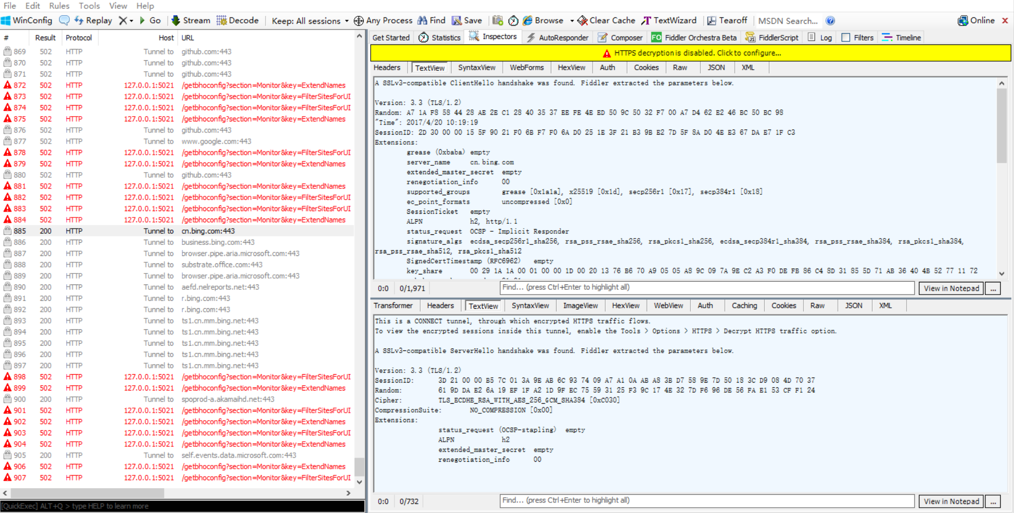
Fiddler

Slide 19
Fiddler
Notes:
Headers, Cookies, response, params all available

Slide 20
Contents
Introduction
Requests
Challenges
Conclusion

Slide 21
Challenges
Exceptions
Get banned
Captcha
Too slow
Cookies

Slide 22
Exceptions
Failure due to overtime, Internet issue, or just simply the request is failed….
Solution: use try except in python

Slide 23
Exceptions

Slide 24
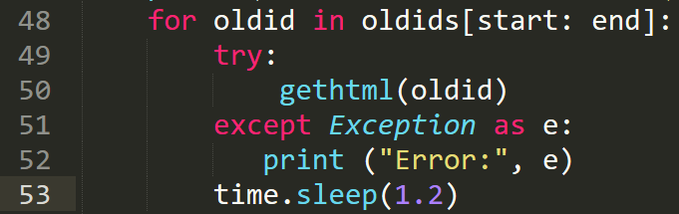
Exceptions

Slide 25
Get banned
The target website may detect the web crawler
Solutions: time.sleep(), proxy pool
Github Proxypool (often works poorly)
https://github.com/Python3WebSpider/ProxyPool

Slide 26
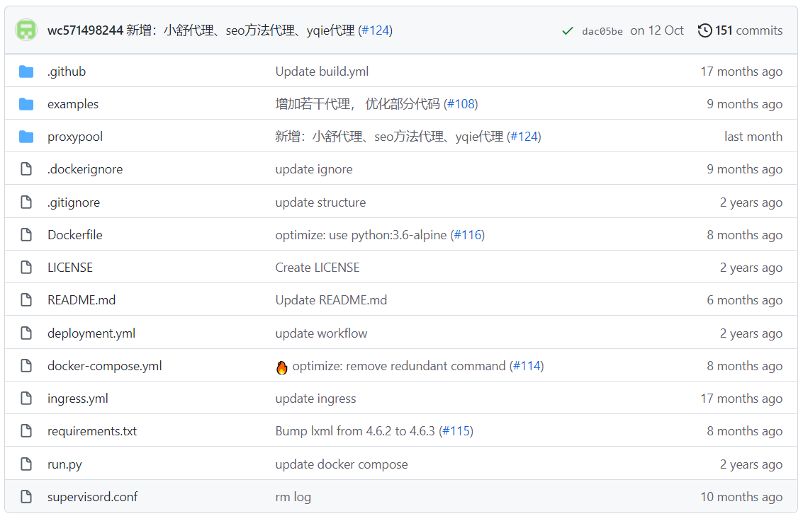
Proxypool steps

Slide 27
Proxypool steps
Run the proxypool
Python run.py
Get a random proxy from the pool
requests.get(proxypool_url).text.strip()
Crawl
requests.get(url, proxies=proxies)

Slide 28
Cookies
Cookies are data, stored in small text files, on your computer.
When a web server has sent a web page to a browser, the connection is shut down, and the server forgets everything about the user.
Cookies were invented to solve the problem "how to remember information about the user":
When a user visits a web page, his/her name can be stored in a cookie.
Next time the user visits the page, the cookie "remembers" his/her name.
Notes:
Problem: wrong cookie wrong response

Slide 29
Cookies
Solutions:
Crack the cookie (hard)
Selenium

Slide 30
Selenium
Selenium Python provides a simple API to write functional/acceptance tests using Selenium WebDriver.
Can download the html and perform operations (eg. Search & click)
Install: pip install selenium; Download the corresponding webdriver

Slide 31
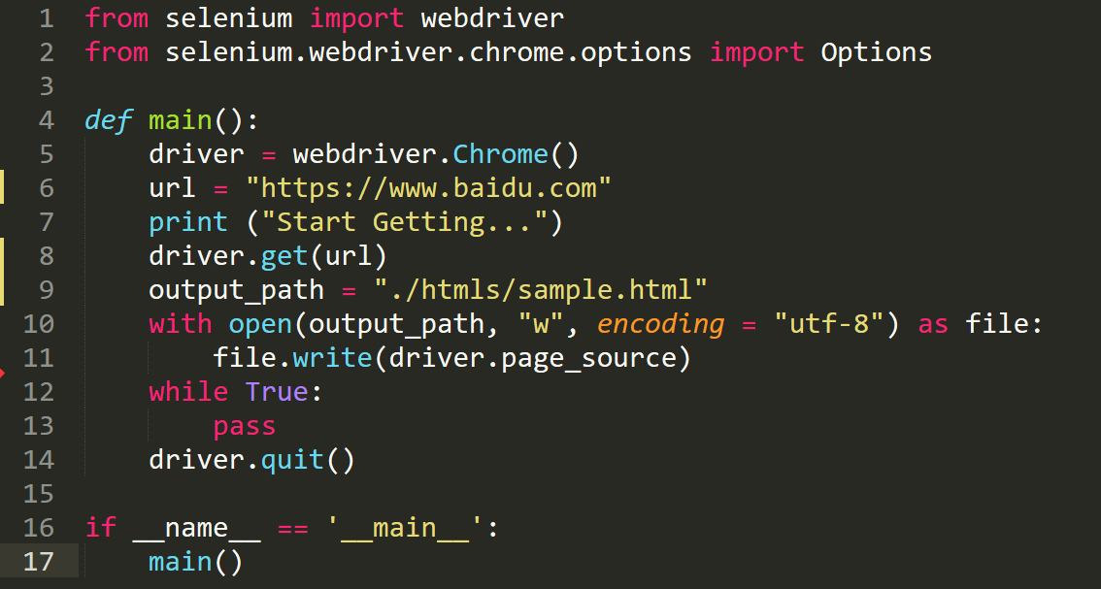
Example: Browse & download the html page

Slide 32
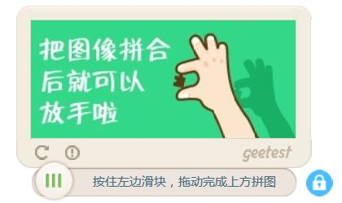
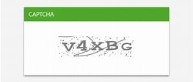
Captcha
Solution:
Operate Selenium (hard)
Find available Api to crack the captcha (maybe) (cost money)
Find blog talking about the captcha (maybe)

Slide 33
Too slow
Loooong time to wait for the response
Solutions: multithreading and multiprocess

Slide 34
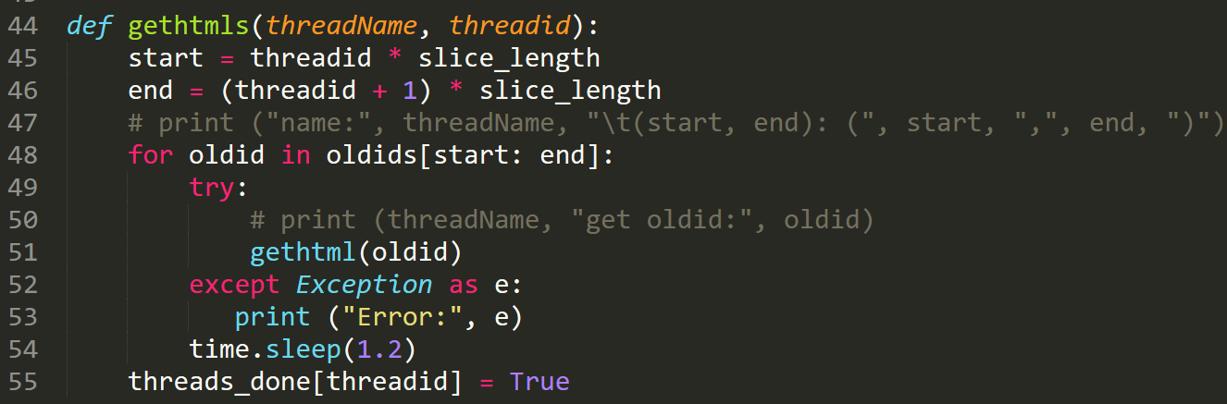
Multithreading
_thread in Python

Slide 35
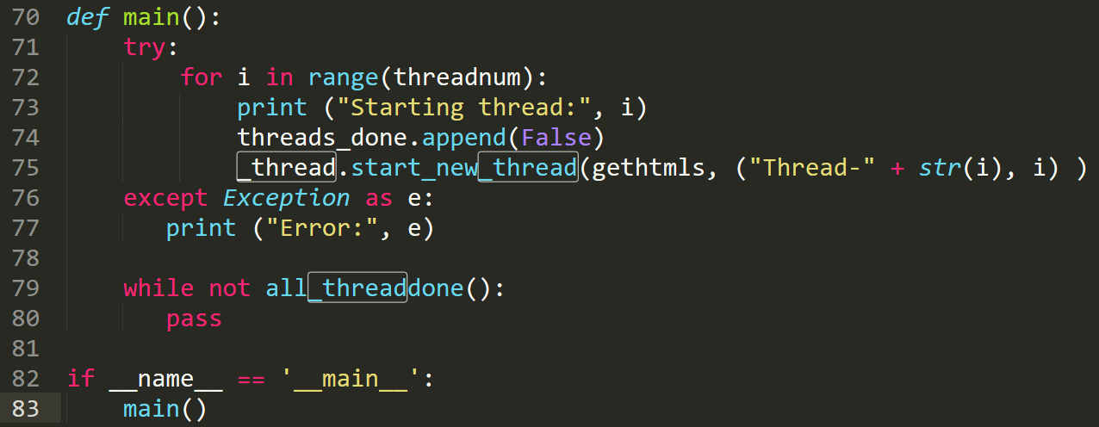
Multithreading
_thread in Python

Slide 36
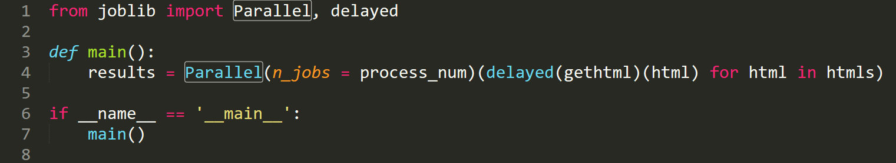
Multiprocess
_joblib in Python

Slide 37
Contents
Introduction
Requests
Selenium
Challenges
Conclusion

Slide 38
Conclusion
Crawler: Three steps
Requests, Postman, Selenium and Fiddler
Challenges: Exceptions, Get banned, Cookies, Captcha and Too slow

Slide 39
Q&A

